Slide 1


PROJECT TITLE
Learning Management System with Machine Learning Course Recommendation
MAJOR PROJECT ODD SEMESTER 2023-24
Presented by: Under the Supervision of:
Ravi Prakash - 20102134 Dr. Jasmine Saini
Mohammed Fayez Khan - 20102148
Department of ECE
Jaypee Institute of Information Technology, Noida, U.P., India

Slide 2
Learning Management System with Machine Learning Course Recommendation

Slide 3
CONTENTS
Introduction to the Project
Stacks Used
Flow Chart
Model Implementation
Machine Learning Implementation
Future Scope
References

Slide 4


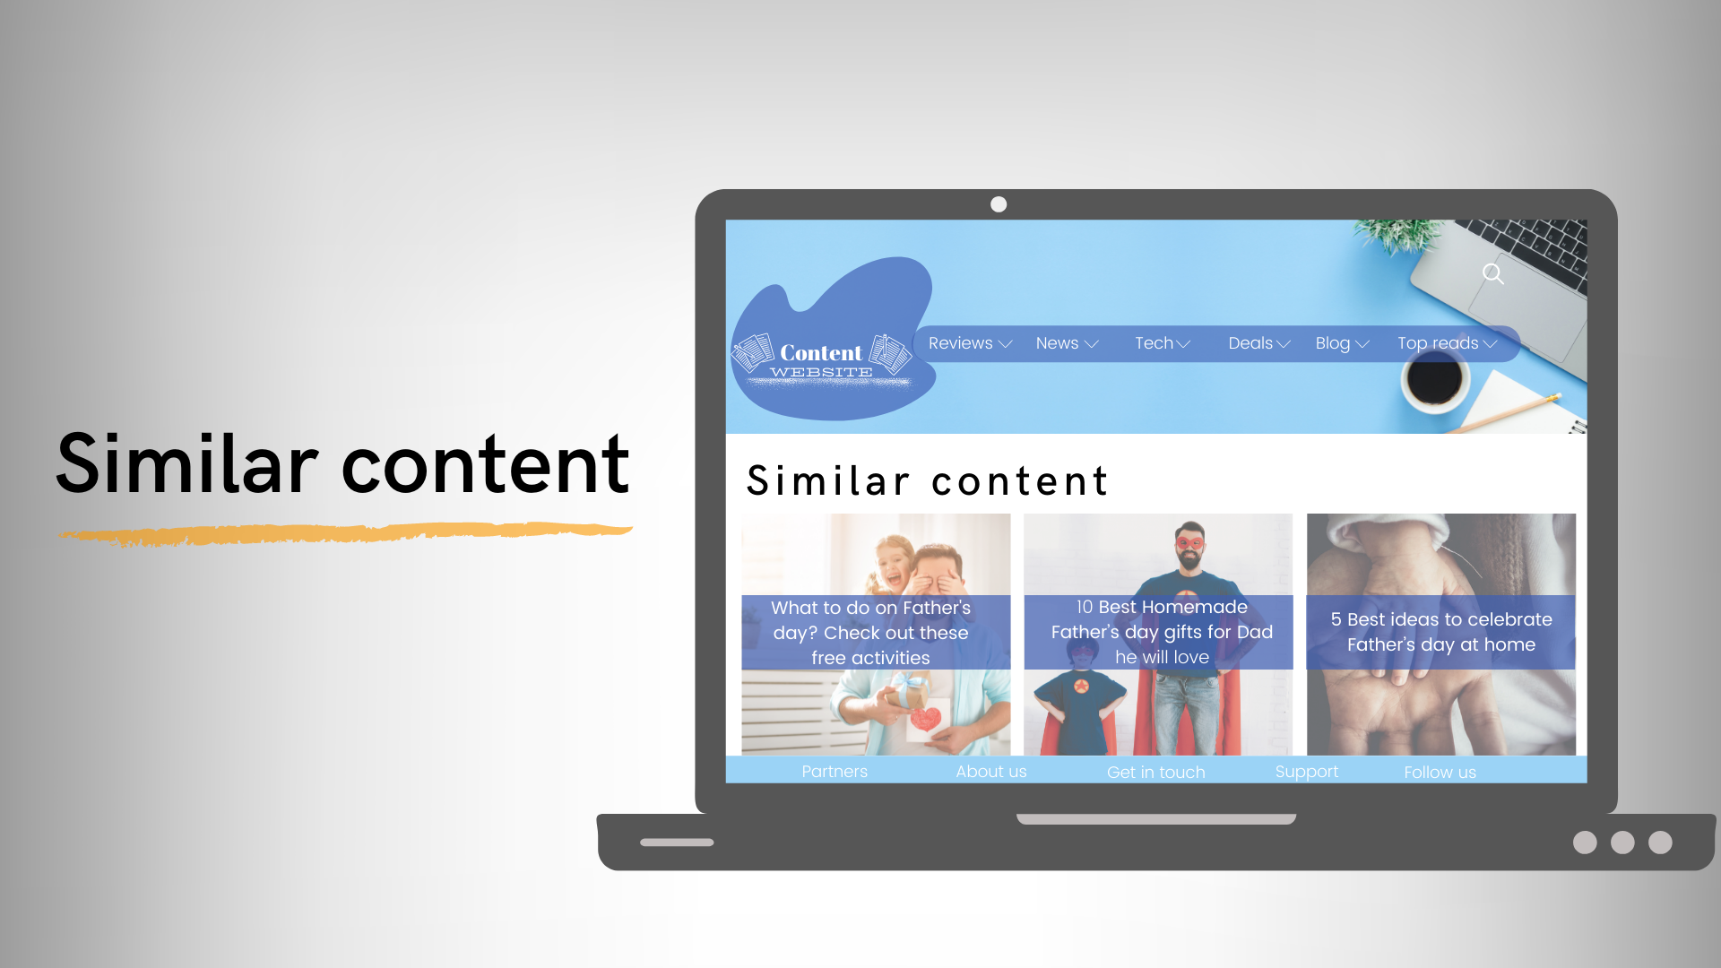
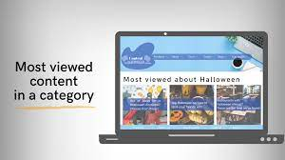

Slide 5
INTRODUCTION TO THE PROJECT
In the realm of online education, our college project aspires
to make a meaningful impact by creating an advanced Learning
Management System (LMS) equipped with a machine learning-
based course recommendation system. At its core, our project
aims to deliver a tailored learning experience that adapts to each
user's unique needs and goals
Frontend interface for users to interact with the platform: a user-friendly search bar, course listings, and sections dedicated to displaying personalized recommendations.
Content-based filtering: to analyze course metadata and provide personalized recommendations.

Slide 6
Goals:
Personalized Learning
User-Friendly Interface
Efficient Video Streaming
Secure Payment Processing
Key Components:
Course Recommendation System
React Application
Video Streaming System
Payment System

Slide 7
STACKS USED
01.
04.
02.
05.
03.
Frontend Excellence
Machine Learning
Next.js and React
collaborative and content-based filtering
Payment Prowess
Data Dominance
Stripe
Prisma, paired with MySQL
Video Virtuosity
Mux

Slide 8
FLOW CHART
FRONTEND
Next.js and React, ensuring a smooth and intuitive experience.
STRIPE
Stripe, a secure payment processing
MUX
Ensuring seamless video content delivery
MACHINE LEARNING
Content-based and Collaborative filtering
BACKEND
Prisma, paired with MySQL
efficiently manages data

Slide 9
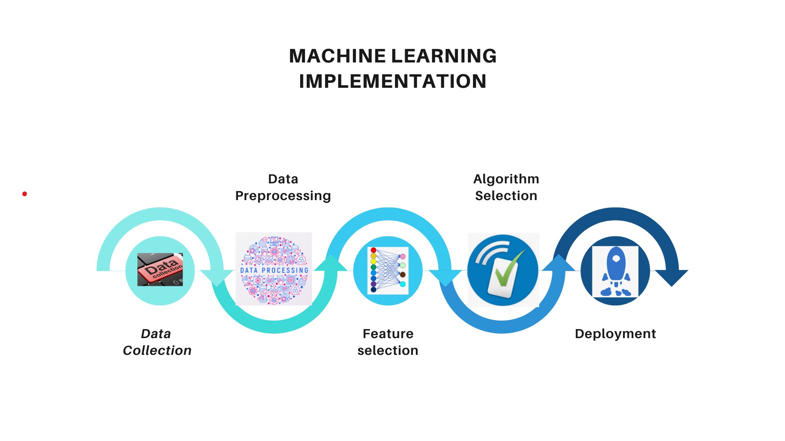

Slide 10


Slide 11
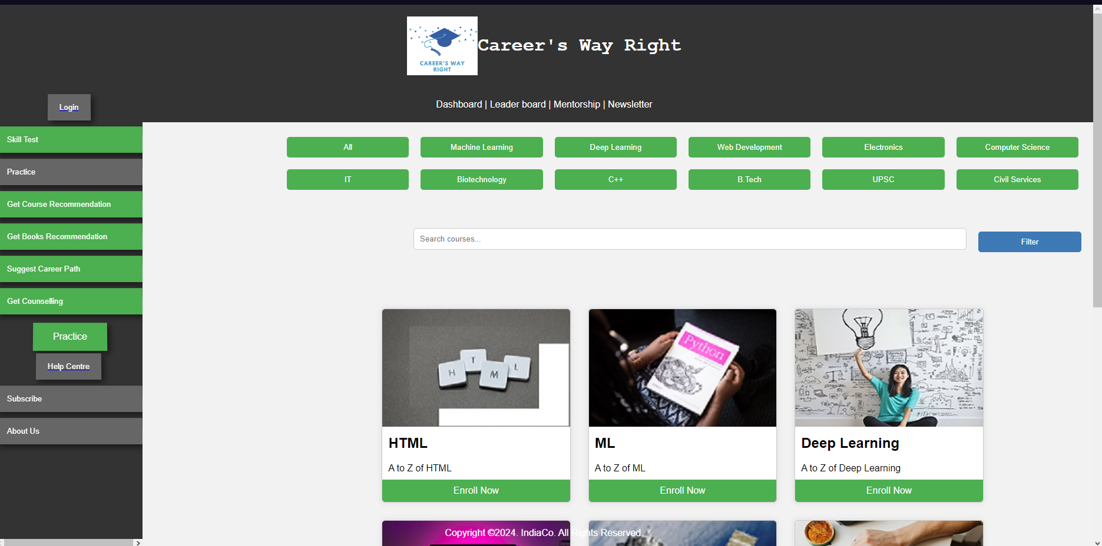
The Landing Page of LMS Website

Slide 12
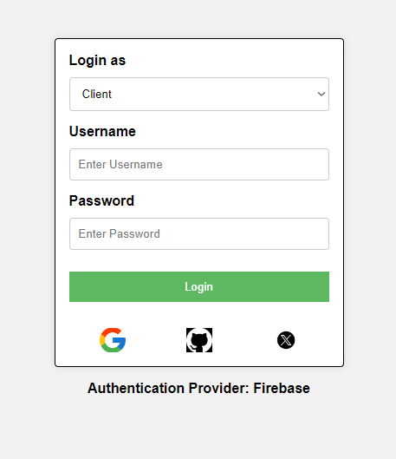
Login Authentication

Slide 13
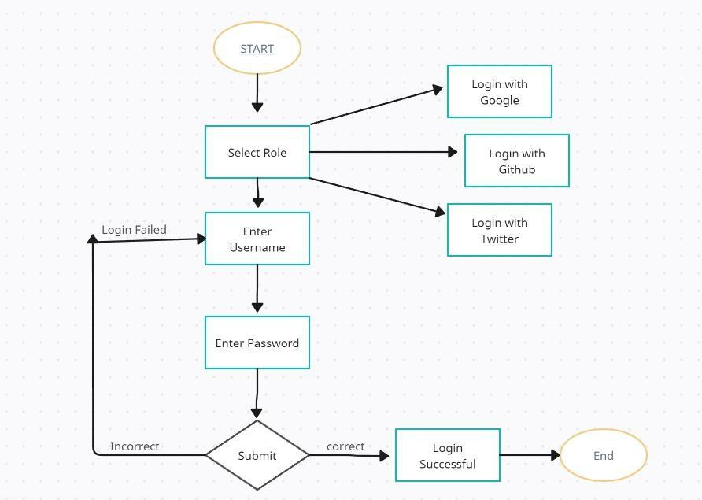
Workflow @LoginAuth

Slide 14
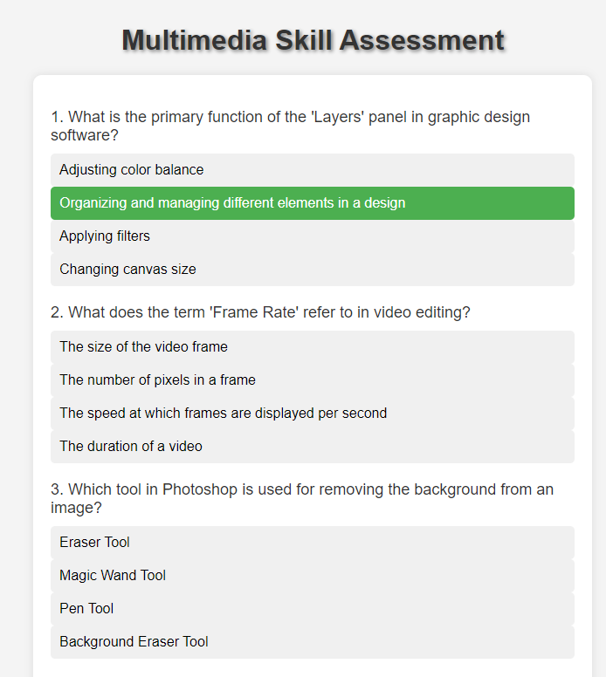
Skill Test

Slide 15
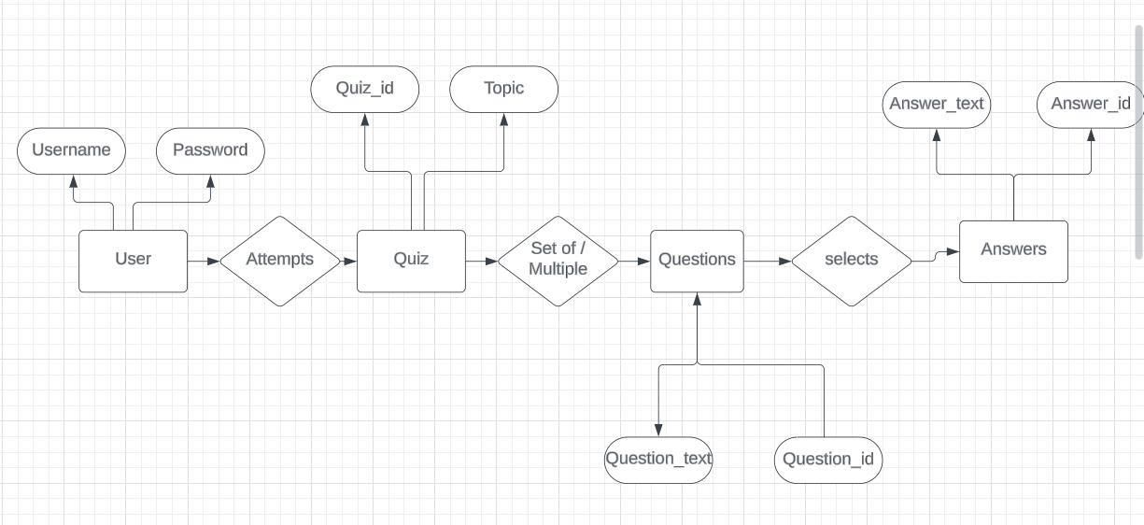
Practice Page

Slide 16
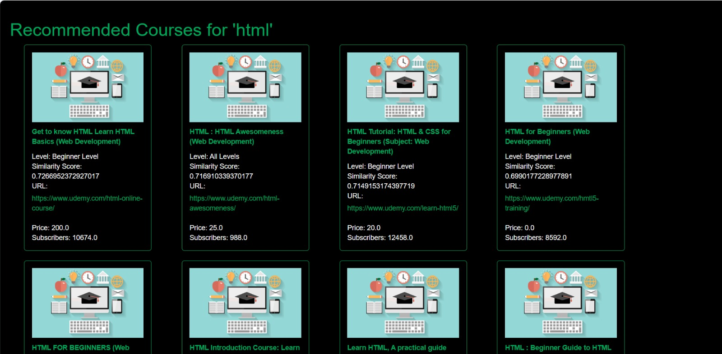
Course Recommendation

Slide 17
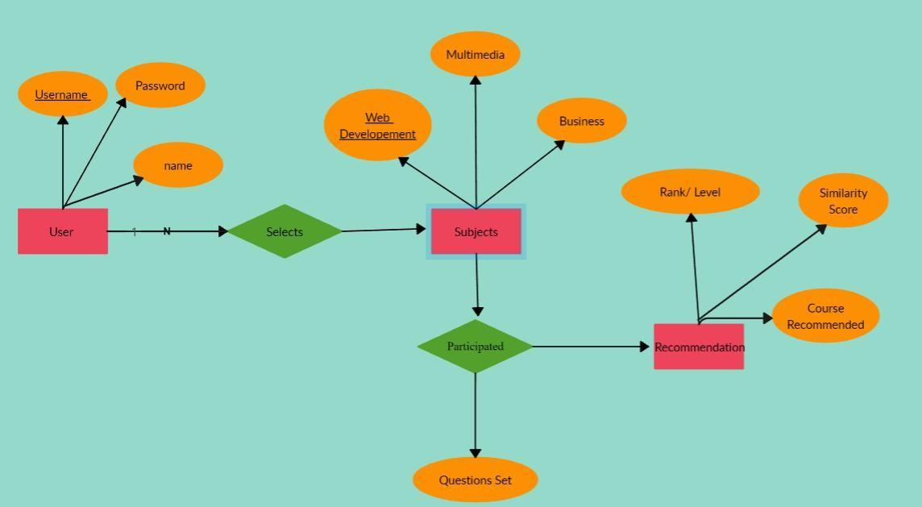
ER Diagram @Course Recommendation

Slide 18
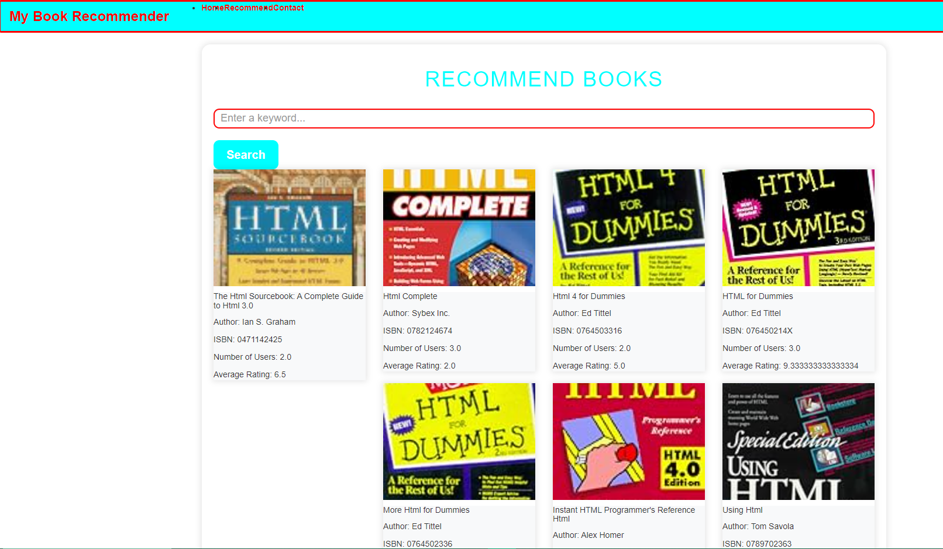
Book Recommender

Slide 19
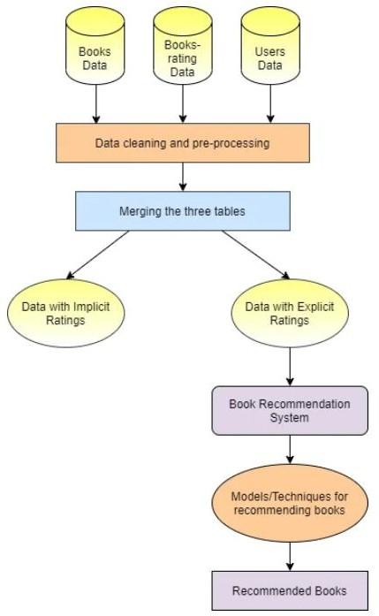
Work Flow @Book Recommendation

Slide 20
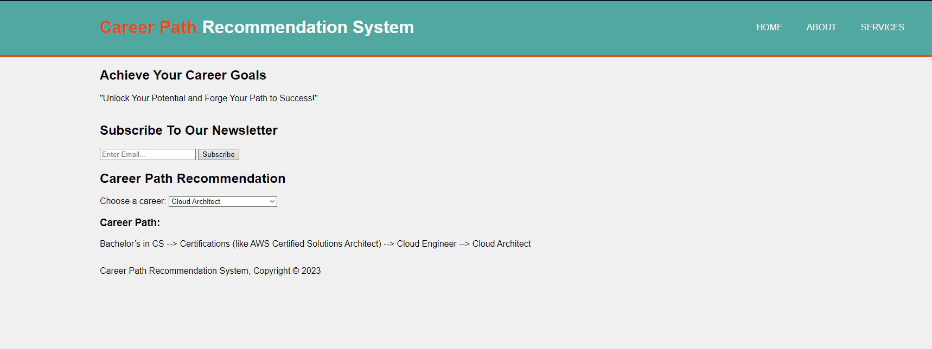
Career Path Recommendation

Slide 21
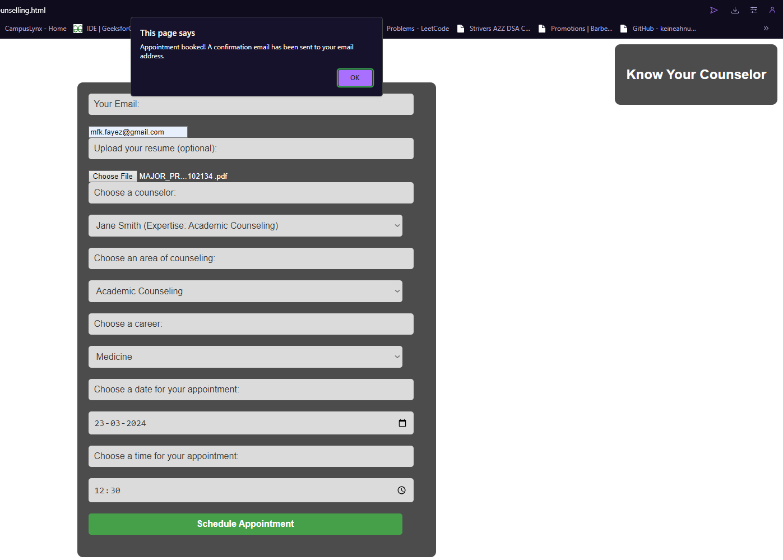
Counselling Page

Slide 22
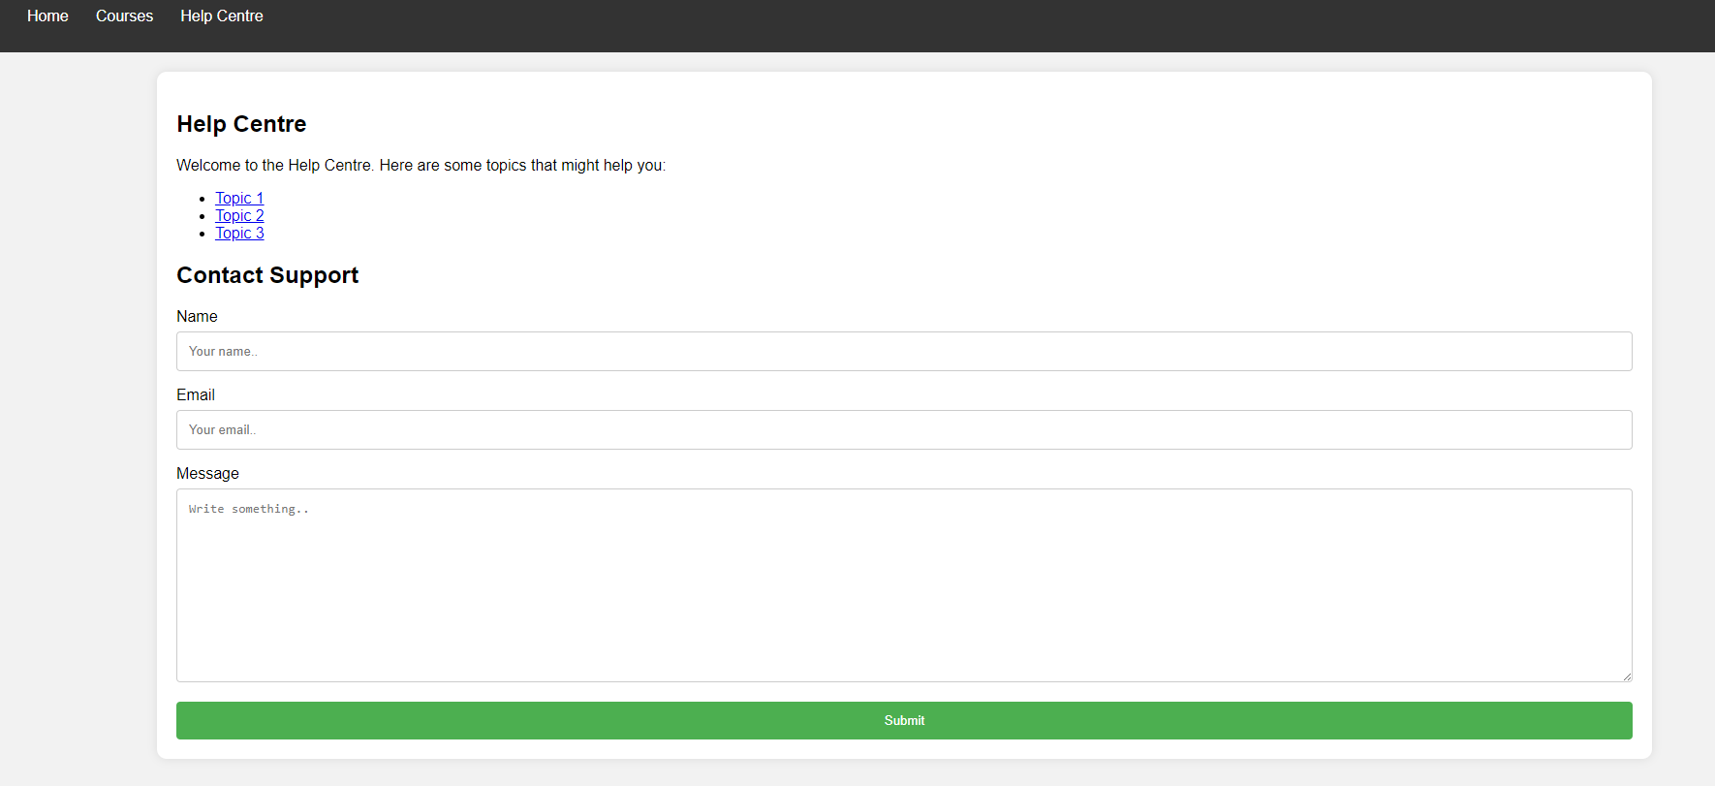
Help Center Page

Slide 23
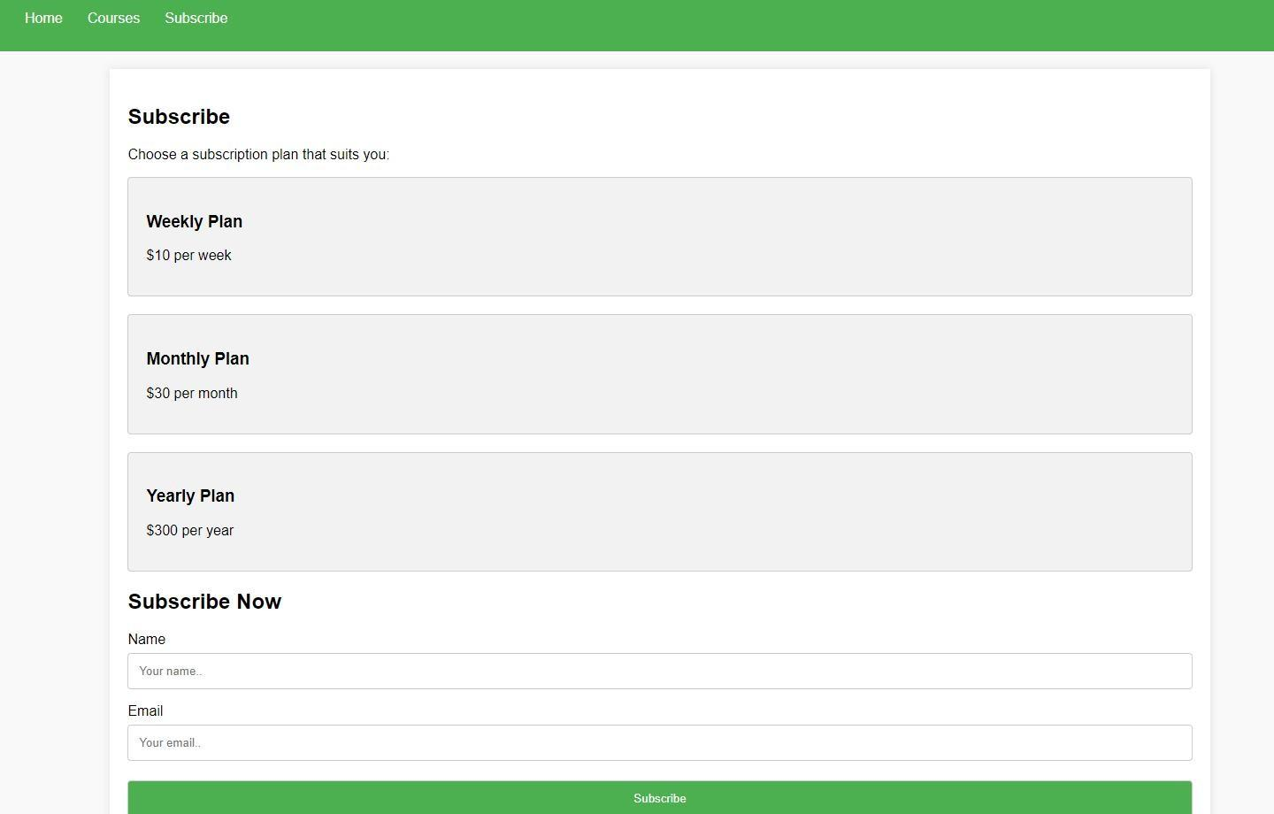
Subscription Page

Slide 24
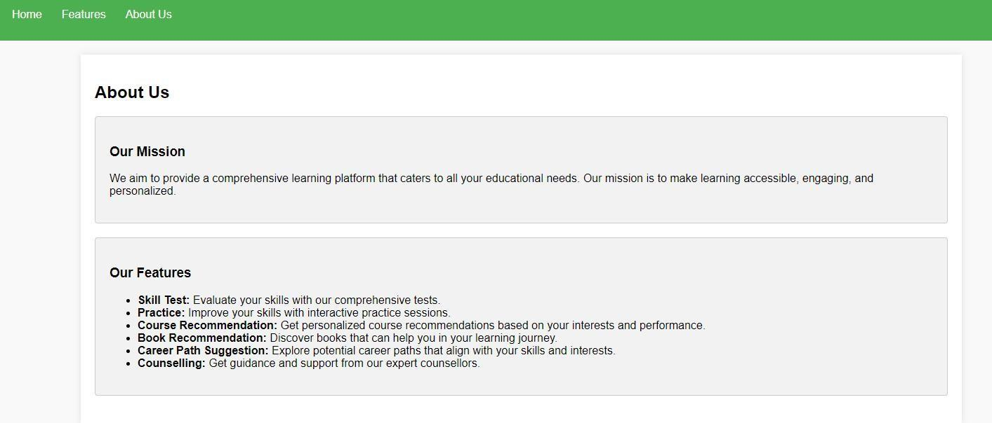
About Us Page

Slide 25
FUTURE SCOPE
To ensure seamless video content delivery using Mux.
Using a fusion of collaborative and content-based filtering, designed to provide users with precisely tailored course suggestions.
A secure payment processing system using Stripe.
Assessing user skills to provide personalized recommendations.

Slide 26
REFERENCES
[1]https://www.kaggle.com/datasets/khusheekapoor/coursera-courses-dataset-2021
[2]Michael J. Pazzani, Daniel Billsus. Content-Based Recommendation Systems. Internet:
[3]H. Jafarkarimi, A. T. H. Sim and R. Saadatdoost, "A naive recommendation model for large databases", International Journal of Information and Education Technology, vol. 2, no. 3, pp. 216, 2012.

Slide 27


